Slide 1

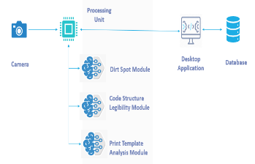
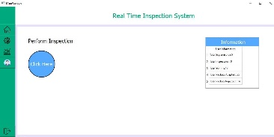
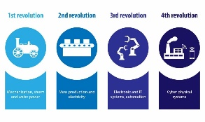
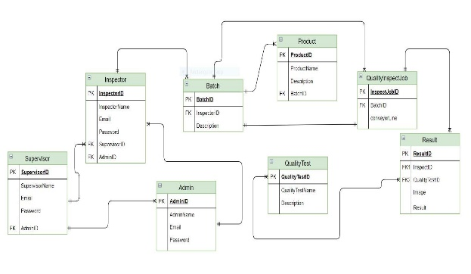
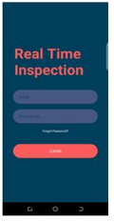
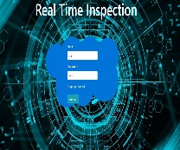



Real-time Machine Vision-based Quality Inspection System for Small and Medium ^{Enterprises} ^{Final Year Project (2017-2021)} ^{Department of Computer Science} COMSATS University Islamabad, Lahore
Introduction
This project aims to develop a real-time machine vision-based quality inspection system for small and medium enterprises. Labelling errors that occur during packaging can damage consumers’ perception of quality. Our system will perform Machine Vision-based measures for quality assessment in real-time . Tests include identification of dirt spots, print template analysis, damaged and missing labels of packaging. The basic aim behind this project is to promote the fourth industrial revolution and Artificial Intelligence in Pakistan
Motivations
Promote the fourth industrial revolution in Pakistan.
Developing a machine-vision based inspection system.
Build a cost-effective system for product quality inspection.
Reduce the time for quality inspection
Automate the quality inspection system which is less costly built and is user friendly.
System Background
In industries, the packaging material of the products are inspected by quality inspector that take lots of time. Some of the products go uninspected due to human error. To overcome this issue, the automated inspection of the packaging material will be done that saves lots of time and the products will be inspected with more accuracy.
Architecture
Results
Desktop Application
To manage the inspection and records.
Conclusion
We are offering the quality inspection of packaging material with the use of industrial 4.0. There will be three members of the system i.e. Admin, Supervisor, and Inspector, they will manage the reports, working of each module of the system. Three tests will be performed by the quality inspection agent, which includes Dirt spot identification, print inspection, code legibility on packaging material to check, show the batch status and improve the packaging material’s quality.
Database Design
Web and Mobile Application
To use the system remotely
Future Directions
In future one more module will be added in the system, which we are not adding in the system this time. The module will identify wrinkles on the top and bottom seal of the packaging material, and we shall improve the other three modules which are already in the system by increasing data set.
Group Members
Abdul Wajid
sp17-bcs-079@cuilahore.edu.pk
Umer Imtiaz
sp17-bcs-067@cuilahore.edu.pk
M. Abdul Muhib
sp17-bcs-103@cuilahore.edu.pk
Supervisor: Dr. Wajahat Mahmood Qazi
Objectives
Develop a real-time Inspection of packaging material.
Develop a module for dirt spot identification of packaging material.
Develop a system to entertain the high-speed production of products.
Develop a system to reduce scrapping in packaging.
Develop a module to recognize printing mistakes on the packaging.
Efficient and accurate inspection of packaging.
Reduce the time of the quality inspection process in packaging.
Develop a cost-effective system

